Slide 1
Mid Project
By:Siddhartha V
Balendra DP

Slide 2
Problem Statement
You would be working on creating a 2-Tier Application Stack setup involving Postgres, Tomcat, and deploying the application in a containerized environment.
The project utilizes Maven to build the artifact, which is then deployed to the Tomcat server.
In this project, PostgreSQL serves as the chosen database management system.
You would be using Github for code management, keep a tab of the Github practices for push and pull. You can use a single branch or utilize multi-branch deployment.
Service Provisioning includes:
Apache Tomcat v9 or v10
PostgreSQL Database
Ensure the firewalls/security groups are configured in a proper manner to allow required ports to be enabled.
The application logic comprises of:
Developing a service that will read weather API data from: https://openweathermap.org/api
URL mapping needs to be done to fetch the following :
Display the current weather data for a location

Slide 3
Workflow
Monitoring+Observibility(Datadog)
Java code +PostGres
Jenkins
Docker
Api Key
OpenWeather

Slide 4
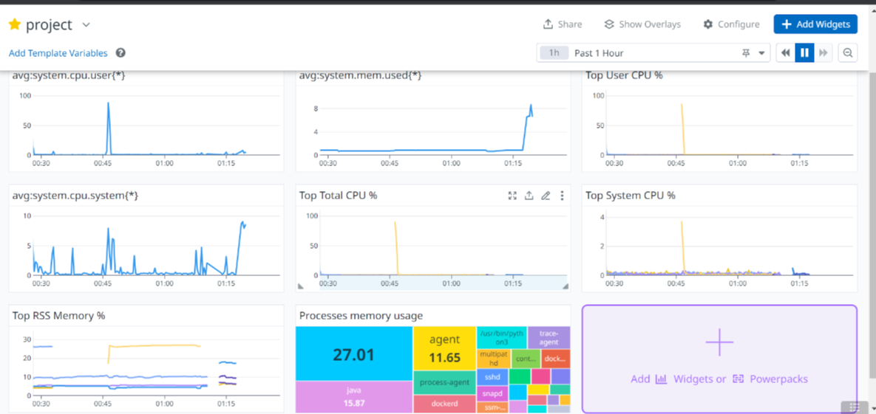
Monitoring

Slide 5
Thank You

